Slide 1

Advanced Partitioning Strategies for Large-Scale Data Management
Database Management System | Storage Structures, Indexing and Query Optimization
Course: Database Management System (DBMS) | Chapter: Storage Structures, Indexing and Query Optimization | Program: B.TECH-CSE, B.TECH CSE - CYBER SECURITY, B.TECH CSE - DATA
DISCOVER · LEARN · EMPOWER
Notes:
Welcome everyone to this lecture on advanced partitioning strategies. We are diving deep into how we manage massive datasets within the context of storage structures. This topic is crucial for understanding how modern databases handle scale. Let us begin by exploring the core concepts that drive efficient data management.

Slide 2
Course Outcomes
SLIDE 2 / 14
Course Outcome
CO | BT LEVEL | DESCRIPTION
CO1 | BT2 | Explain database architecture, relational model concepts and formal query language foundations including relational algebra and relational calculus.
CO2 | BT3 | Apply relational algebra, relational calculus and SQL constructs to formulate correct and efficient database queries.
CO3 | BT4 | Analyze functional dependencies and design normalized relational schemas up to 5NF ensuring lossless join and dependency preservation.
CO4 | BT4 | Analyze transaction schedules and concurrency control mechanisms to determine serializability, recoverability and correctness.
CO5 | BT5 | Evaluate storage structures, indexing strategies and query optimization techniques for performance, scalability and reliability.
Chandigarh University
2 / 14
Notes:
Today's lecture directly addresses our first two course outcomes. We will explain how partitioning alters the database architecture and storage model. You will also learn to apply these concepts to formulate more efficient queries for large-scale data. This ensures you can handle real-world data challenges effectively.

Slide 3
Learning Objectives
SLIDE 3 / 14
Learning Outcomes
1
Analyze the fundamental differences between horizontal and vertical partitioning strategies.
2
Evaluate the performance impact of partitioning on query execution time.
3
Demonstrate the application of range and hash partitioning with numerical examples.
4
Critique common pitfalls in partition key selection for large datasets.
Chandigarh University
3 / 14
Notes:
By the end of this session, you will be able to analyze different partitioning types. We will evaluate how these strategies change query performance significantly. You will also demonstrate your understanding through specific numerical examples. Finally, we will critique common mistakes to avoid in production environments.

Slide 4
Lecture
SLIDE 4 / 14
Definition of Advanced Partitioning
1
Partitioning divides a large table into smaller, manageable logical units called partitions.
2
Each partition stores a subset of rows or columns while maintaining logical integrity.
3
The database treats the partitioned table as a single logical entity to the user.
4
Physical storage locations can vary across different disks or storage nodes.
5
This strategy is essential for managing tables exceeding hundreds of gigabytes in size.
Chandigarh University
4 / 14
Notes:
Think of partitioning as splitting a massive library into smaller, organized sections. The user still sees one library, but the books are stored in different rooms. This allows the system to manage data that is too large for a single disk. It is the foundation of scalable database architecture.

Slide 5
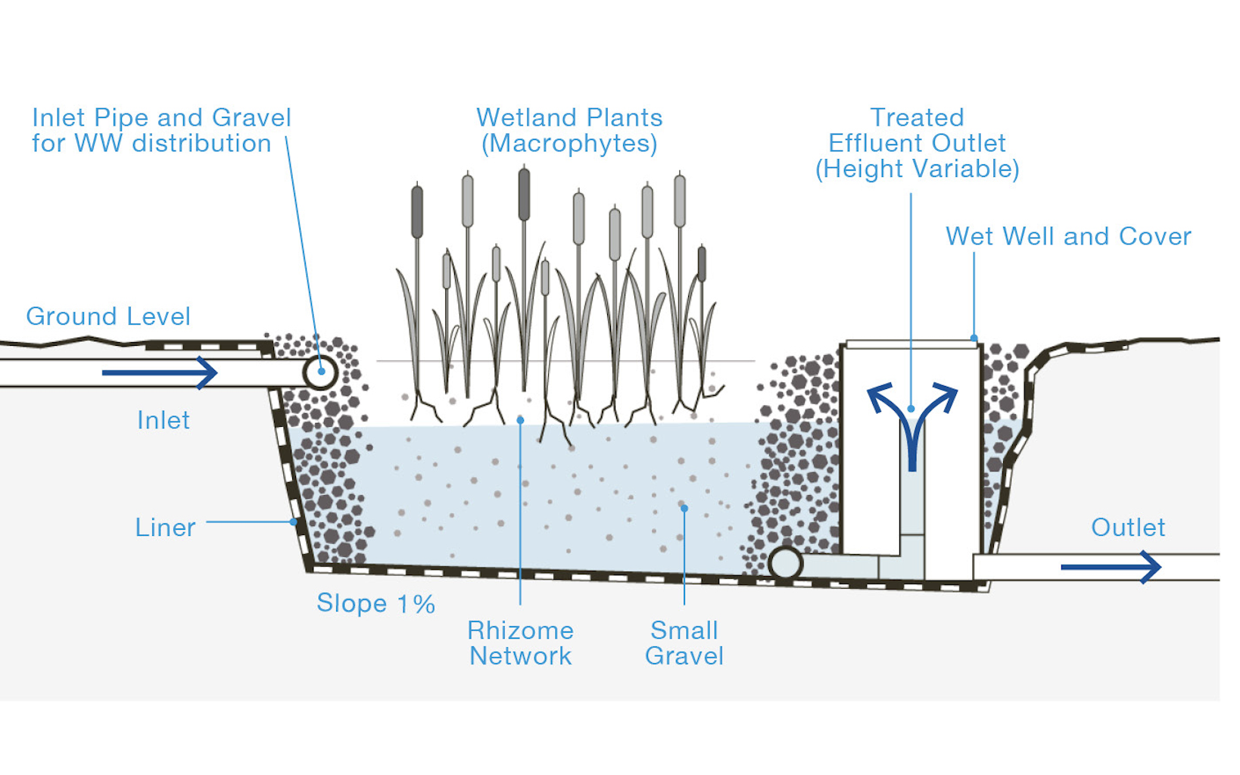
Lecture
SLIDE 5 / 14
Horizontal Partitioning (Sharding)
EXAMPLE
Storing 2023 sales data in one partition and 2024 in another.
• Horizontal partitioning splits rows based on a specific predicate or range condition.
• Each partition contains a unique subset of rows from the original table.
• Common methods include range, list, and hash partitioning for row distribution.
• Query performance improves as the optimizer scans only relevant partitions.
Source: sanihub.info
Chandigarh University
5 / 14
Notes:
In horizontal partitioning, we slice the table like a loaf of bread. Each slice contains specific rows, perhaps based on a date range. If you query for 2023 data, the system ignores the 2024 slice entirely. This drastically reduces the amount of data scanned during a query.

Slide 6
Lecture
SLIDE 6 / 14
Vertical Partitioning Strategy
1
Vertical partitioning splits columns into separate tables based on access patterns.
2
Frequently accessed columns are kept together, while rarely used columns are separated.
3
This reduces I/O overhead by loading only necessary columns into memory.
4
It improves cache efficiency for queries that do not require all columns.
5
Join operations are required to reconstruct the full logical row from partitions.
Chandigarh University
6 / 14
Notes:
Vertical partitioning is like separating a heavy textbook into a core reader and a reference appendix. You only load the core pages for a quick read. This reduces the data volume scanned by the storage engine. However, you must join the tables to see the complete record.

Slide 7
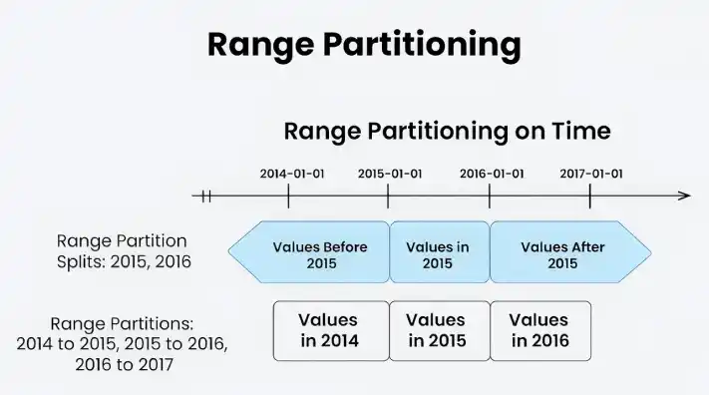
Lecture
SLIDE 7 / 14
Range Partitioning Mechanics
EXAMPLE
Partitioning customer IDs from 0-1000, 1001-2000, and so on.
• Range partitioning distributes rows based on a column value falling within a range.
• Partitions are defined by upper bounds, such as years, months, or numeric intervals.
• Queries with range predicates on the partition key are highly optimized.
• The partition pruning mechanism eliminates irrelevant partitions from the scan.
Source: media.geeksforgeeks.org
Chandigarh University
7 / 14
Notes:
Range partitioning is ideal for time-series data or ordered numeric keys. The database knows exactly which partition holds the data for a specific year. This allows for instant pruning of irrelevant data. It is the most common strategy for historical data management.

Slide 8
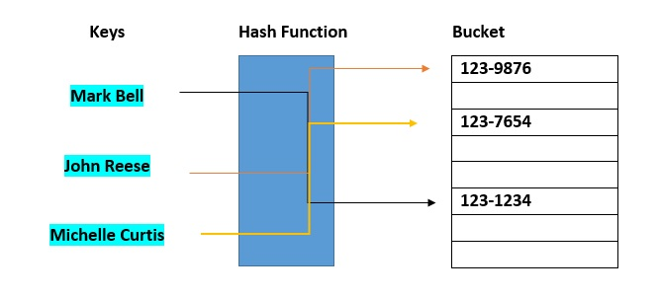
Lecture
SLIDE 8 / 14
Hash Partitioning Mechanics
1
Hash partitioning uses a hash function on the partition key to assign rows.
2
Rows are distributed evenly across partitions regardless of the data value.
3
This ensures uniform load balancing across multiple storage nodes or disks.
4
It is optimal for queries that require equality checks on the partition key.
5
Range queries are less efficient as they may require scanning all partitions.
Source: www.databricks.com
Chandigarh University
8 / 14
Notes:
Hash partitioning is like dealing cards to players to ensure an even game. It spreads data uniformly, preventing hotspots on specific disks. This is perfect for high-volume transactional systems. However, it struggles with range queries because the data is not ordered.

Slide 9
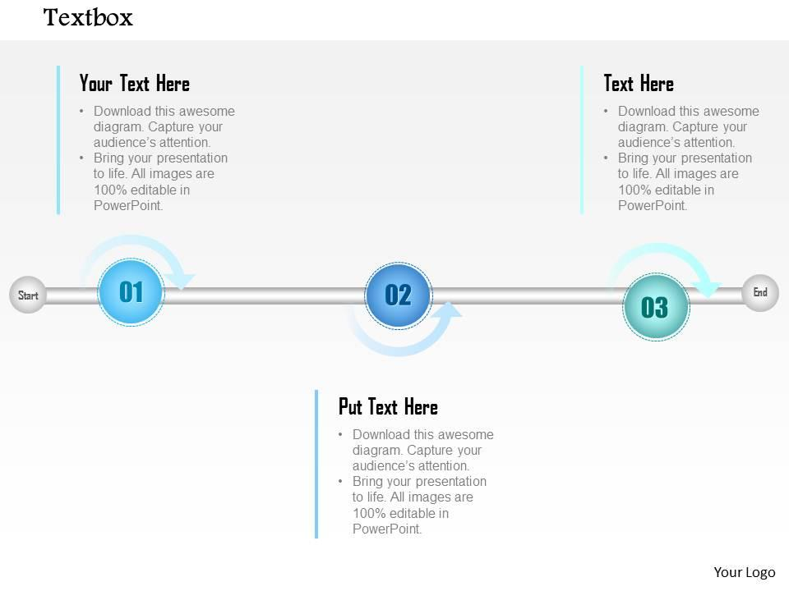
Worked Example
SLIDE 9 / 14
Range Partitioning
GOVERNING EQUATION
Query: SELECT × FROM Orders WHERE Order_Date = '2022-05-01'
1
Consider a table with 10 million rows partitioned by 'Order_Date'.
2
Partition P1 holds dates 2020-2021, P2 holds 2022-2023, P3 holds 2024.
3
The optimizer scans only Partition P2, ignoring P1 and P3 entirely.
4
Scan time reduces from 100% of data to approximately 33% of data.
Source: www.slideteam.net
Chandigarh University
9 / 14
Notes:
Let's look at a concrete example with 10 million rows. If we query for a date in 2022, the system skips the 2020 and 2024 data. This reduces the scan time by roughly two-thirds. This is the power of partition pruning in action.

Slide 10
Worked Example
SLIDE 10 / 14
Hash Partitioning
GOVERNING EQUATION
Hash function: H(ID) = ID mod 4, creating 4 partitions (P0 to P3)
QUERY
SELECT × FROM Orders WHERE Customer_ID = 12345.
CALCULATION
12345 mod 4 = 1, so the system scans only Partition P1.
• Table has 1 million rows partitioned by 'Customer_ID' using a hash function.
• Scan time reduces from 100% to 25% of total data volume.
Chandigarh University
10 / 14
Notes:
Here we use a modulo operation to distribute data. For customer ID 12345, the math tells us it belongs in partition 1. The database ignores the other three partitions completely. This ensures that equality lookups are extremely fast and predictable.

Slide 11
Lecture
SLIDE 11 / 14
Partition Pruning Mechanism
1
Partition pruning is a query optimization technique that skips irrelevant partitions.
2
The optimizer analyzes the WHERE clause to identify the relevant partition range.
3
It generates a plan that accesses only the necessary physical storage segments.
4
This reduces I/O operations and CPU usage significantly for large tables.
5
Pruning is automatic and transparent to the application layer.
Chandigarh University
11 / 14
Notes:
Partition pruning is the engine that makes partitioning useful. The query optimizer looks at your conditions and decides which partitions to touch. It effectively tells the storage engine to ignore the rest. This happens automatically without any code changes from your side.

Slide 12
Common Pitfalls
SLIDE 12 / 14
Poor Key Selection
EXAMPLE
Partitioning by 'Gender' creates two massive partitions instead of many.
• Choosing a partition key with low cardinality leads to uneven data distribution.
• A key with few unique values causes 'hot spots' on specific partitions.
• This negates performance benefits and creates load balancing issues.
• Always select a key with high cardinality for optimal distribution.
Chandigarh University
12 / 14
Notes:
A common mistake is picking a bad key, like gender or status. If you partition by gender, you only get two partitions, which is useless for scaling. You end up with one huge partition and one small one. Always choose a key with many unique values to spread the load.

Slide 13
Lecture
SLIDE 13 / 14
Key Takeaways
1
Partitioning splits large tables into logical units to improve manageability and performance.
2
Horizontal partitioning splits rows, while vertical partitioning splits columns.
3
Range partitioning suits ordered data, while hash partitioning suits uniform distribution.
4
Partition pruning allows the optimizer to scan only relevant data subsets.
5
Selecting a high-cardinality partition key is critical to avoid hotspots.
Chandigarh University
13 / 14
Notes:
To summarize, partitioning is a powerful tool for large-scale data management. You must choose between horizontal and vertical strategies based on your access patterns. Remember that pruning is the key to performance, and key selection is the key to balance. Mastering these concepts will make you a better database designer.

Slide 14
Lecture
SLIDE 14 / 14
References
1
Fundamentals of Database Systems — Ramez Elmasri & Shamkant B. Navathe
2
Database System Concepts — Silberschatz, Korth & Sudarshan
3
Database Management Systems — Raghu Ramakrishnan & Johannes Gehrke
4
Oracle/MySQL Documentation — Oracle
Chandigarh University
14 / 14
Notes:
These are the standard texts you should consult for deeper insights into these topics. Elmasri and Navathe provide excellent theoretical foundations. Silberschatz offers a comprehensive view of system concepts. Ramakrishnan and the Oracle documentation provide practical implementation details. Please review these for your assignments and exams.

